Slide 1
Link Error Detection and Failure Recovery in Software Defined Networking
Project Guide Dr. V.Mary Anita Rajam
Team2.G14 (members)
SWETHA V.S.(2012103078)
THILLAIRAJA S.T.S.(2012103611)
SUNIL N.K. (2012103602)

Slide 2
INTRODUCTION
“Software-Defined Networking “(SDN) is an emerging architecture that is dynamic, manageable, cost-effective, and adaptable, making it ideal for the high-bandwidth, dynamic nature of today’s applications.
This architecture decouples the network control and forwarding functions enabling the network control to become directly programmable and the underlying infrastructure to be abstracted for applications and network services.
The Open Flow protocol is a foundational element for building SDN solutions.
SDN Architecture is,
• Directly programmable
• Centrally managed
• Programmatically configured
• Open standards-based and vendor-neutral

Slide 3
OBJECTIVES
Links are the cardinal feature of any communication network and so preserving those link is our core purpose.
Link breakage causes some serious damage to the network like dropping of packets , unreliable communication , etc.
Our Objective is to provide a reliable network without any faults. Detecting and recovery of the link is the prime objective. But maintaining the link is a difficult task

Slide 4
And also to provide an alternate path if the main link is broken or damaged and this allows the proposed approach to avoid potential congestion in the post-recovery network by choosing proper backup paths.
By coordinating among SDN switches, we can also explore multiple backup paths for the failure recovery

Slide 5
LITERATURE SURVEY
S NO | REFERENCE PAPERS | PUBLICATIONS AND YEAR | EXPLANATION
1 | Detour Planning for Fast and Reliable Failure Recovery in SDN with OpenState | Design of Reliable Communication Networks (DRCN), 2015 11th International Conference on 24-27 March 2015 | Provides a secure and a reliable path in case of link failure. Ensures zero packet loss in this mechanism. Routing technique used here is MPLS.
2 | Openflow Path Fast Failover Fast Convergence Mechanism | Network Research Proceedings of the Asia-Pacific Advanced Network 2014 v. 38, p. 23-28 | The paper deals with a fast and efficient failover mechanism for redirecting traffic to more optimal backup path when there is a link failure or congestion problem in SDN. It also proposes a local pre-calculated path dataset mechanism in OpenFlow controller to allow fast network convergence.
3 | A Europe-wide demonstration of fast network resto- ration with OpenFlow | IEICE Commun. Express, vol. 3, no. 9, pp. 275–280, 2014. | Segment protection is the key feature used to reroute the data in the secondary route which may or may not be the best or optimal path. Independent Transient Plane (IPL) is designed in this paper which reduces the path complexity and maintains the security of the data.
4 | OpenFlow-Based Segment Protection in Ethernet Networks | IEEE/OSA Journal of Vol 5 ,No 1, September 2013 | This paper is based on providing a segment based rerouting algorithm for efficient transfer of messages in case of link failures.

Slide 6
S NO | REFERENCE PAPERS | PUBLICATIONS AND YEAR | EXPLANATION
5 | Orion: A Hybrid Hierarchical Control Plane of Software-Defined Networking for Large-Scale Networks | 2014 IEEE 22nd International Conference on Network Protocols. | This paper explains the Orion architecture which overcomes the issues of the flat control plane structure and the centralized abstracted hierarchical structure of the control plane.
6 | Fast Recovery in Software-Defined Networks | IEEE Software Defined Networks (EWSDN), 2014 Third European Workshop on 1-3 Sept. 2014 | This paper implements a failover scheme with per-link Bidirectional Forwarding Detection sessions and preconfigured primary and secondary paths computed by an OpenFlow controller. Uses two steps- switch-initiated recovery and then controller calculating the optimal paths.
7 | Fault-Tolerant OpenFlow-based Software Switch Architecture with LINC Switches for a Reliable Network Data Exchange | Research and Educational Experiment Workshop (GREE), 2014 Third GENI 19-20 March 2014 | This paper describes the usage of the Erlang Distributed System to replace the hardware switches with open flow software switches to better the fault-tolerance system.

Slide 7
S NO | REFERENCE PAPERS | PUBLICATIONS AND YEAR | EXPLANATION
8 | Efficient routing for traffic offloading in Software-defined Network | International Workshop on Software Defined Networks for a New Generation of Applications and Services (SDN-NGAS-2014) | In Automatic Re-routing with Loss detection architecture re-routing is done by by eliminating the node at which the packet loss occurred due to congestion and an alternative route to transmit the packet is found to reduce the packet loss due to congestion.
9 | Relaxed Multiple Routing Configurations: IP Fast Reroute for Single and Correlated Failures | IEEE Transactions on network and service management, vol 6, no. 1, MARCH 2009. | The paper puts forth the methodology employed to recover from link failures in a network with the help of Relaxed Multiple Routing Configuration (rMRC).
10 | Scalable Resilience for Software-Defined Networking Using Loop-Free Alternates with Loop Detection | Network Softwarization (NetSoft), 2015 1st IEEE Conference | This paper explains about the usage of Loop Free Alternatives(LFAs) to prevent single or multilink failures. Depending upon the three condition in which the LFAs occur, loops might be formed in case of node failure. Hence, a loop detection strategy is used to detect and drop those packets.

Slide 8
PROPOSED SYSTEM
Our system is based on the process of detecting the link failure in a network and providing a secure path for the packets.
As in most cases, the re-routing path provided is pre-computed already and is stored in the table.
Even if it’s being the common trite , the networks in existence today are blindly dependent on this framework.
The existing system uses a working and a transient plane.
Working plane is used till the link failure occurs and then the transient plane comes into play when a link is failed.
The transient plane is like a tree in which the failure node is the root.

Slide 9
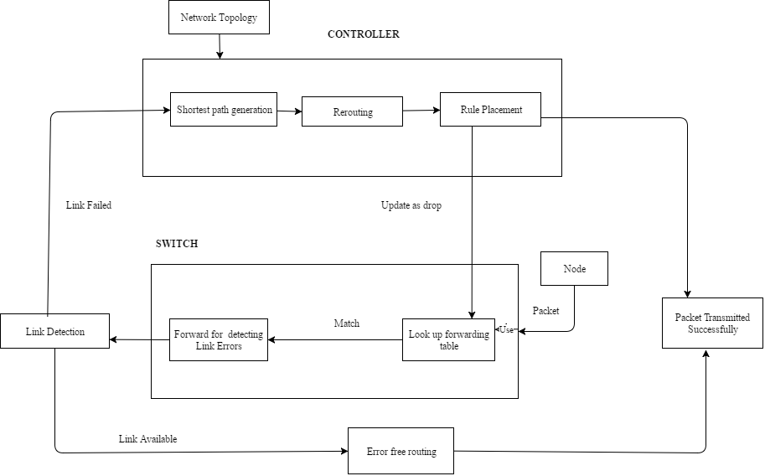
ARCHITECTURE DIAGRAM

Slide 10
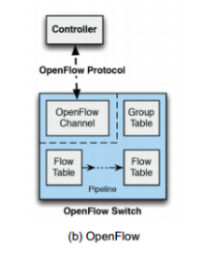
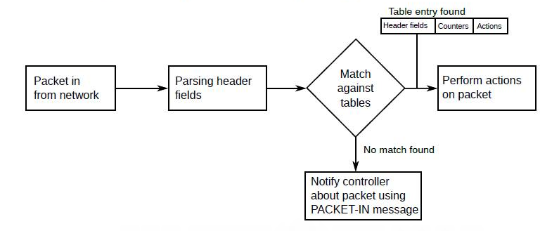

Slide 11
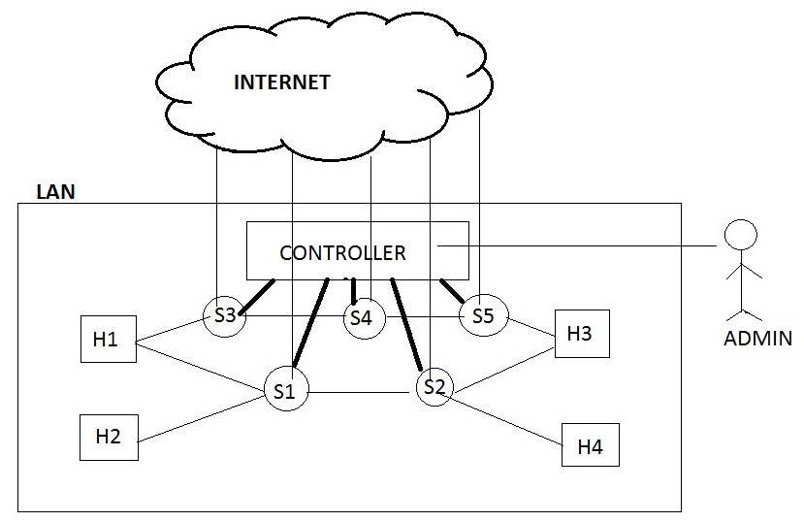
COMPONENTS OF THE SYSTEM

Slide 12
COMPONENTS OF THE SYSTEM
H1...H4 : Hosts within the LAN
S1 …S5 : Switches within the LAN with OpenFlow support
Controller : The centralized controller that controls the switches within the LAN
Admin : The one who configures the controller based on the requirements
The switches are connected to the adjacent switches and the hosts nearby. All the switches within the LAN report to the same controller. The switches are connected to the Internet, to retrieve the page source of the site requested

Slide 13
MODULES DESIGN:
Detection Module :
Detection of link failure
Recovery Module:
Storing of dropped packets in compression state.
Handling the failed link using the alternate back path.
Stored packets are sent using fast rerouting technique.

Slide 14
Detection Module :
Detection of link failure:
Link between nodes is considered to be the framework for any network and so preserving the link is cardinal.
If the network link is error free ,it reroutes and finally transmits the packets without any loss.
If a link failure is detected, the nodes between the failed link is identified. After the detection of link failure, input is then passed to the recovery module,and the
open flow protocol intimates the SDN controller.

Slide 15
PSEUDO CODE:
for each switch in a network
sending & receiving beacon signals to nearby switches
IF (link failure detected)
identify the failed link between switches
link array[] = store the failed link
initialize link flag bit =1
IF (packet loss > buffer limit in switches)
stop the packet transmission from the source.
pass the packet flow to recovery module
modify the routing table and initialize the flag bit =1.
intimate the SDN Controller.
ELSE
re routing the packets without loss.

Slide 16
Recovery Module :
Storing of dropped packets in compression state.
Handling the failed link using the alternate back path (the packets which are not left from the source).
Stored packets are sent using fast rerouting technique.
Packets that are not left from the source are rerouted in pre-calculated alternate path.
Packets that are transmitted before the detected failed link are stored in the switch in the compressed state . The stored packets are then decompressed and fast rerouted to the destined node.
SDN controller controls all the rerouting paths using Dijkstra’s algorithm.

Slide 17
PSEUDO CODE:
IF (link flag bit is set)
Packets which haven’t started from the source are need to be stopped.
Re route the packets from the source in alternated precalculated path.
IF (flag bit is set)
Packets which had started from source are made to stored in a switch in a compressed state before the failed link which is stored in link array[].
Stored switch intimates SDN Controller using OpenFlow protocol.
SDN Controller decompresses the packets
Finding the next alternate shortest path is done by using Dijkstra’s Algorithm

Slide 18
CONTROLLER (POX)
POX is an open source development platform for Python-based software-defined networking (SDN) control applications, such as Open flow SDN controllers. POX, which enables rapid development and prototyping, is becoming more commonly used. The ultimate goal for POX is to use it to create “an archetypal, modern SDN controller.”
POX Controller Features:
“Pythonic” OpenFlow interface.
Reusable sample components for path selection, topology discovery, etc.
“Runs anywhere” – Can bundle with install-free PyPy runtime for easy deployment.
Specifically targets Linux, Mac OS, and Windows.
Topology discovery.
Supports the same GUI and visualization tools as NOX.
Performs well compared to NOX applications written in Python.

Slide 19
PSEUDO CODE :
def handle_packetIn(packet):
out_port = 2
if packet.in_port == 2:
out_port = 1
flow_mod = ofp_flow_mod()
flow_mod.match = ofp_match()
flow_mod.match.in_port = \
packet.in_port
action = ofp_action_output()
action.out_port = out_port
flow_mod.action = [ action ]
flow_mod.buffer_id = \
packet.buffer_id
send(flow_mod)

Slide 20
COMPRESSION ALGORITHM :
Run length compression:
This algorithm consists of replacing large sequences of repeating data(packets) with only one item of this data(packets) followed by a counter showing how many times this item is repeated.
The data packets are replaced with a compression code, one of the data packets, and a value that represents the number of data packets to repeat.

Slide 21
PSEUDO CODE :
message = 'aaaaaaaaaabbbaxxxxyyyzyx';
function run_length_encode($msg)
{
$i = $j = 0;
$prev = '';
$output = '';
while ($msg[$i]) {
if ($msg[$i] != $prev) {
if ($i && $j > 1)
$output .= $j;
$output .= $msg[$i];
$prev = $msg[$i];

Slide 22
$j = 0;
}
$j++;
$i++;
}
if ($j > 1)
$output .= $j;
return $output;
}
// a10b3ax4y3zyx
echo run_length_encode($message);
Thus we can compress data packets in the switches without packet loss as much as possible.

Slide 23
PATH CALCULATION MODULE:
The module helps in calculating the optimal path between two hosts within the same LAN network.
To implement this, three algorithms have been used, namely,
• The shortest path algorithm
• The ports calculation algorithm

Slide 24
SHORTEST PATH ALGORITHM:
This algorithm computes the best path(shortest) to reach the destination host within the LAN network, when provided with the source, destination and the graph topology as inputs.
def spath(graph,start,end,path=[]):
temp-path=[start]
add tmp-path to queue
while q is not empty
dequeue q to tmp-path
last-node=tmp-path[len(tmp-path)-1]

Slide 25
(Contd..)
print tmp-path
if last-node == end
tm-path is a valid path
for link node in graph[last -node]
if link node not in tmp-path
newpath = tmp-path+ link-node
q.enqueue(new path)
return tmp-path

Slide 26
PORTS CALCULATION ALGORITHM:
Once the path is found, the controller needs the input and output ports along the path to update the rules in the switches. To find the ports, the port calculation algorithm is used. This algorithm provides the input and output ports of the switches in the calculated path when the source, destination and a list of ports connections are given as input.
The algorithm helps in calculating the in-port and out-port of the switches along the path between the source and the destination.

Slide 27
(Contd..)
The variable path is the path calculated by shortest path algorithm.
l1[]and l2[] are the list of hosts and switches having connection between each
other. l3[] is the list of port number through which l1[i] (each node) is connected to l2[i] (each node )
ports=[]
for j in range(0,len(path)):
for i in range(0,len(l1)):
if l1[i]==path[j]:
if l2[i]==path[j+1]
ports.append(l3[i])
return ports

Slide 28
IMPLEMENTATION DETAILS:
1.Open the Terminal application on your computer (Windows users will use PuTTY).
In the Terminal window, use the SSH client on your computer to start an SSH session to the Mininet VM.
ssh -Y mininet@192.168.56.101
In the Terminal window, which is now running an SSH session connected to the Mininet virtual machine, start an Xterm:
xterm -sb &
2.The MiniEdit script is located in Mininet’s examples folder. To run MiniEdit, execute the command:
$ sudo ~/mininet/examples/miniedit.py
MiniEdit has a simple user interface that presents a canvas with a row of tool icons on the left side of the window, and a menu bar along the top of the window.

Slide 29
(Contd..)
3.Add eight switches and three controllers using the same method: Click on the Switch tool and add switches, then click on the Controller tool and add controllers.
4.To start the simulation scenario, click the Run button on the MiniEdit GUI. In the terminal window from which you started MiniEdit,
you will see some messages showing the progress of the simulation startup and then the Miniedit CLI prompt (because we checked Start CLI box in the MiniEdit preferences window).

Slide 30
5.First, check the switch configurations in the network simulation to verify that everything is set up correctly.
You can run the MiniEdit menu command, Run . Show OVS Summary to see an listing of switch configurations.
In this case, we can verify that each switch is listening to the correct controller on the correct port.
6.Then, run a ping command to send traffic between host h1 to h8.
mininet > pingall
In the MiniEdit console, you see the results of the ping command

Slide 31
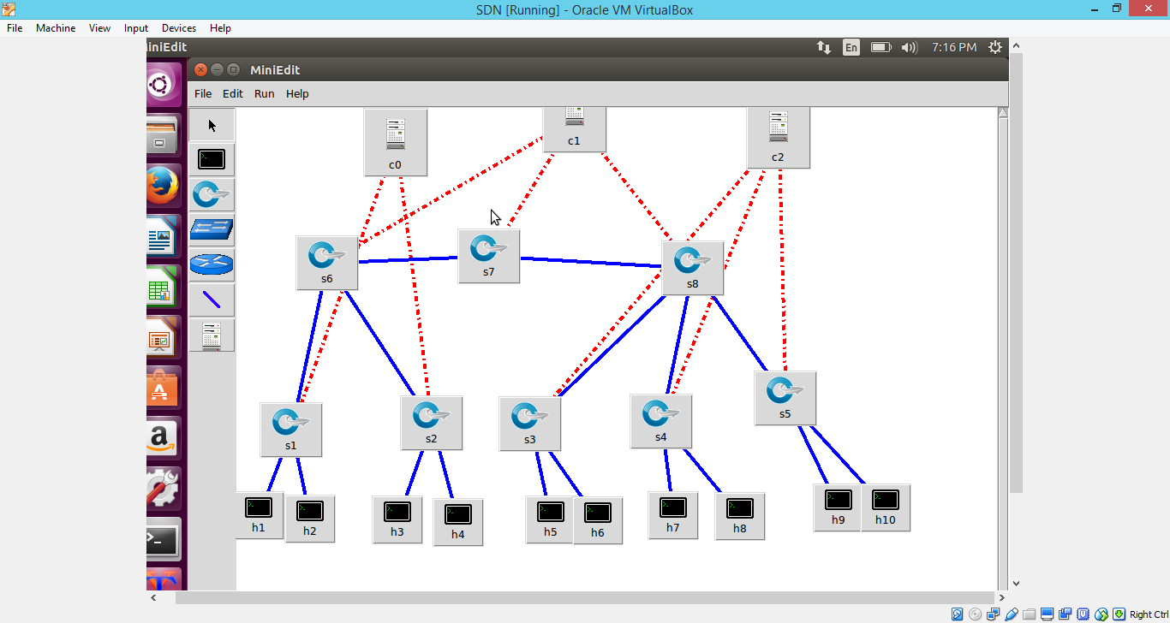

Slide 32
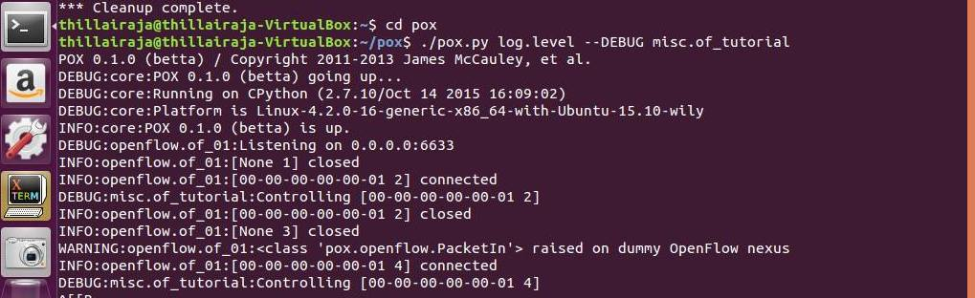

Slide 33
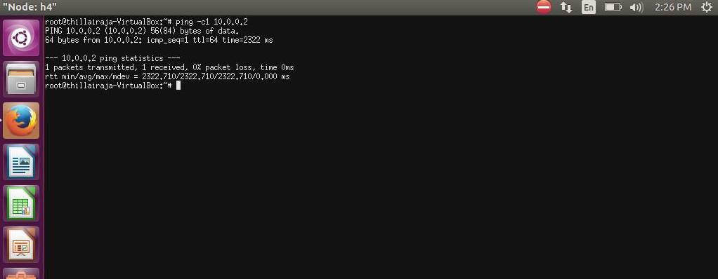

Slide 34
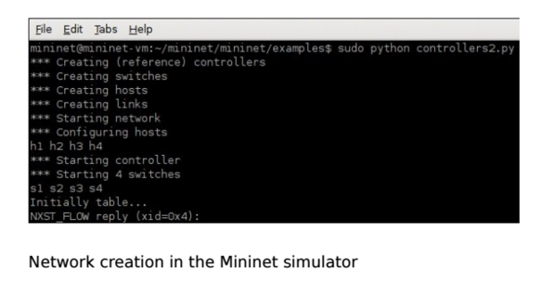

Slide 35
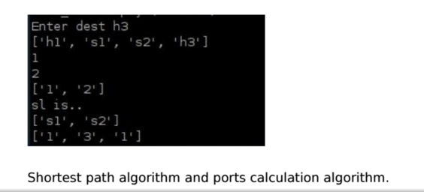

Slide 36
METRICS FOR EVALUATION:
Buffer space overhead
Link failure
Average recovery time (ms)
Number of entries per switch vs Number of switches(N)
Time(ms) vs Number of entries per switch

Slide 37
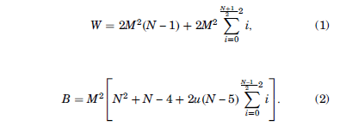
(Contd..)
N values higher than 13 are not supported by the server running Mininet.
Equations (1) and (2), Respectively detail the amount of working entries W and backup entries
B in each switch of a ring network as a function of N and M, in the any-to-any communication worst case:

Slide 38
LINK FAILURE
Once the shortest path is calculated, the links along the path are checked if they are up. If not, the current calculated path is neglected and
a second optimal path is calculated between the source and destination and the process is continued.

Slide 39
BUFFER SPACE OVERHEAD
A threshold, which specifies the maximum number of packets in each switch, is determined when the network is created. For each request, before the switch is loaded up to the buffer limit, the packets already present is compared against the threshold. If it exceeds the threshold,the packets are rerouted through the shortest path.

Slide 40
REFERENCES
Gandhimathi Velusamy, Deniz Gurkan , Sandhya Narayan ,“Fault-Tolerant OpenFlow-based Software Switch Architecture with LINC Switches for a Reliable Network Data Exchange”, Research and Educational Experiment Workshop (GREE), 2014 Third GENI 19-20 March 2014
Braun W, Menth M , “Scalable Resilience for Software-Defined Networking Using Loop-Free Alternates with Loop Detection”, Network Softwarization (NetSoft), 2015 1st IEEE Conference.
Giorgetti A, Cugini F , Paolucci F, Castoldi P,“Optical Communications and Networking, IEEE/OSA Journal ” of Vol. 5 ,No 1, September 2013.

Slide 41
Yonghong Fu, Jun Bi, Kai Gao, Ze Chen, Jianping Wu and Bin Hao, “Orion: A Hybrid Hierarchical Control Plane of Software-Defined Networking for Large-Scale Networks” , 2014 IEEE 22nd International Conference on Network Protocols.
N. Kitsuwan, F. Slyne, S. McGettrick, D. B. Payne, and M. Ruffini, “A Europe-wide demonstration of fast network resto- ration with OpenFlow,” IEICE Commun. Express, Vol. 3, no. 9, pp. 275–280, 2014.
Niels L. M. van Adrichem, Benjamin J. van Asten and Fernando A. Kuipers, “Fast Recovery in Software-Defined Networks” in IEEE Software Defined Networks (EWSDN), 2014 Third European Workshop on 1-3 Sept. 2014
Antonio Capone, Carmelo Cascone, Alessandro Q.T. Nguyen , Brunilde Sanso“Detour Planning for Fast and Reliable Failure Recovery in SDN with OpenState” Design of Reliable Communication Networks (DRCN), 2015 11th International Conference on 24-27 March 2015

Slide 42
Nor Masri Sahri and Koji Okamura, “Openflow Path Fast Failover Fast Convergence Mechanism” , Network Research Workshop Proceedings of the Asia-Pacific Advanced Network 2014 Vol. 38, p. 23-28
Sang Min Park, Seungbum Ju, Jaiyong Lee,“Efficient routing for traffic offloading in Software-defined Network” International Workshop on Software Defined Networks for a New Generation of Applications and Services (SDN-NGAS-2014)
Tarik , Audun Fosselie Hansen, Amund Kvalbein, Matthias Hartmann, R¨udiger Martin, Michael Menth,Stein Gjessing, and Olav Lysne, ”Relaxed Multiple Routing Configurations: IP Fast Reroute for Single and Correlated Failures” , IEEE Transactions on network and service management, Vol.6, no.1,March 2009.

Slide 43
CONCLUSION
Thus the link failures in SDN is handled in an efficient manner by the technique of storing in switch buffers
Also , the packets are not lost and the network is reliable because the link failure is handled efficiently

